Slide 1
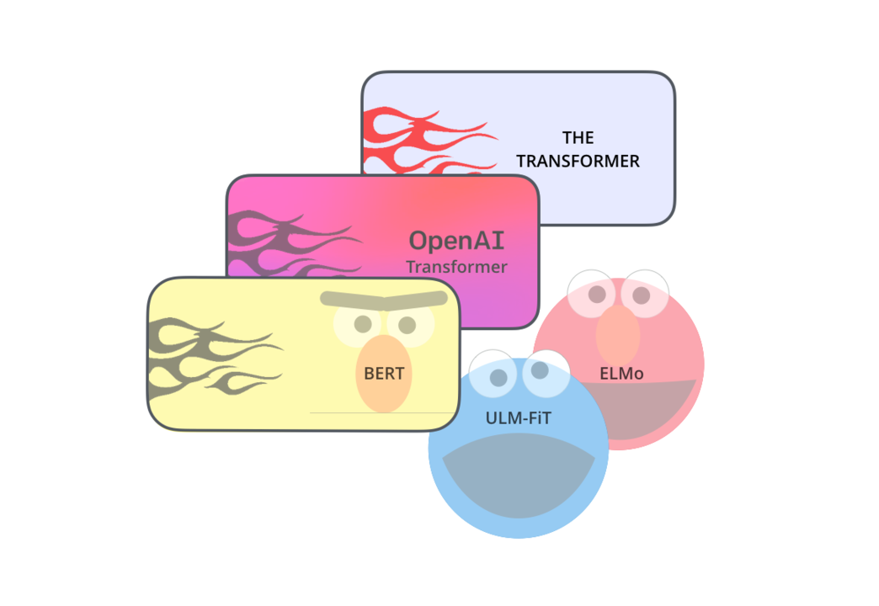
State-of-the-art Language Modeling
Joseph Prusa

Slide 2
Natural Language Processing (NLP)
NLP encompasses any task concerned with the processing of human (natural) language. This includes:
Syntax
Semantics
Discourse
Speech
Dialogue
We will be focusing on text based NLP rather than speech.
NLP can be performed with either rule based or statistical models (machine learning)
Rule based for simple tasks where it is feasible to implement exhaustive logic to cover all (or almost all) scenarios correctly. Think str.split(), regex and other pattern based approaches
Statistical models instead are trained to learn their own logic or decision making process. This enables them to pick up concepts and trends that may not have been known or apparent to the human observer.

Slide 3
Common tasks with written language Include:
Natural Language Processing (NLP)
Syntax
Lemmatization
Part-of-speech tagging
dependency parsing
sentence breaking
Semantic
Machine translation
Language generation
Named Entity Recognition
Relationship extraction
Question Answering
Sentiment Analysis (text classification)
Topic segmentation

Slide 4
What is a Language Model and Why is it important?
While statistical and rule based models have been employed for decades, Language Models are a more recent development enabled by deep learning approaches.
Building upon the likes of word2vec, doc2vec and seq2seq models, language models are trained to internalize general language concepts through clever unsupervised training tasks, large networks and vast quantities of unlabeled data.
Due to the inherent knowledge of language stored within a language model, they are adaptable to a wide variety of NLP tasks assuming the new task is using the same language as the base model.
In addition to beating previous benchmarks, the rise of language models such as ELMo, BERT and GPT-2 have pushed performance in many NLP tasks to super human levels and enabled effective models to be trained with less data via Transfer learning.
Many pretrained language models are freely available along with code repositories. Getting up and running with a language model is fairly easy and enabled you to reach state of the art results with minimal effort.

Slide 5
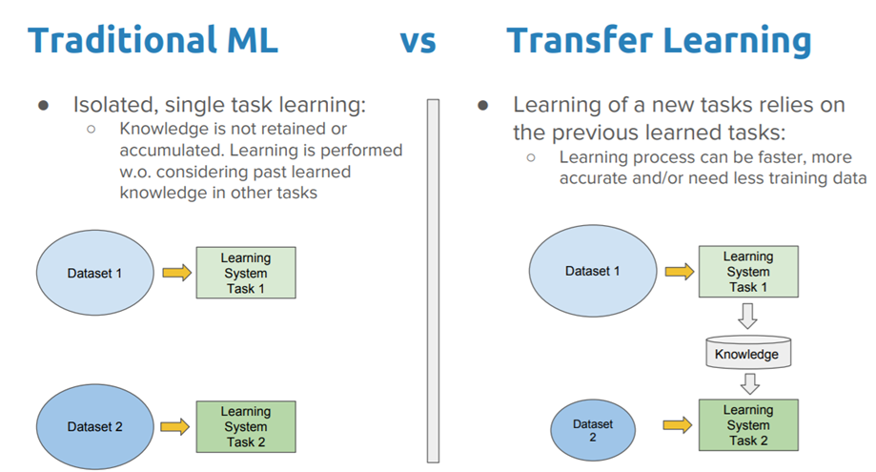
Transfer Learning

Slide 6

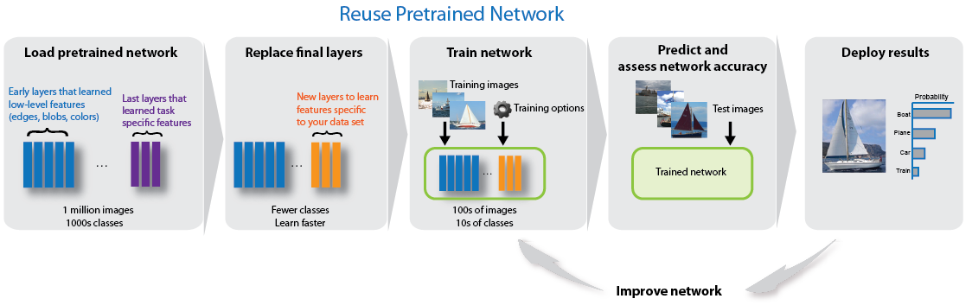
Transfer Learning for Image Classification

Slide 7
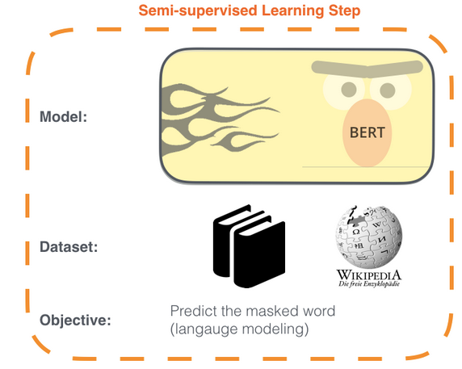
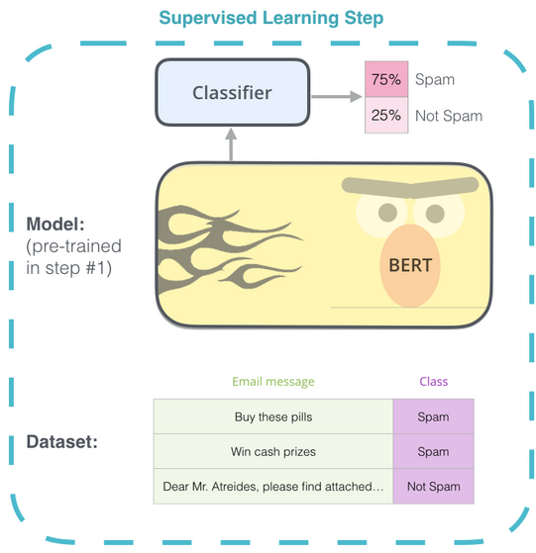
Transfer Learning with Language Models

Slide 8
Progress Towards Language Models
Word and Document Vectors
Word2Vec
Skipgram – co-occurrence in a window of fixed size/time
Global Vectors for Word Representation (GloVe)
Co-occurrence matrix (frequency and context)
Embeddings from Language Models (ELMo)
Bidirectional LSTM used for word Embedding to create contextualized embeddings that change with context vs. the fixed embeddings of previous approaches
Encode-Decode Paradigm
Seq2Seq
Bidirectional LSTM encoder and decoder
Encodes document into vector capturing the meaning of the document
Decodes vector into something (classification, transition etc.)
Transformer
Bidirectional Encoder Representations from Transformers (BERT)
Generative Pre-Training (GPT and GPT-2)

Slide 9
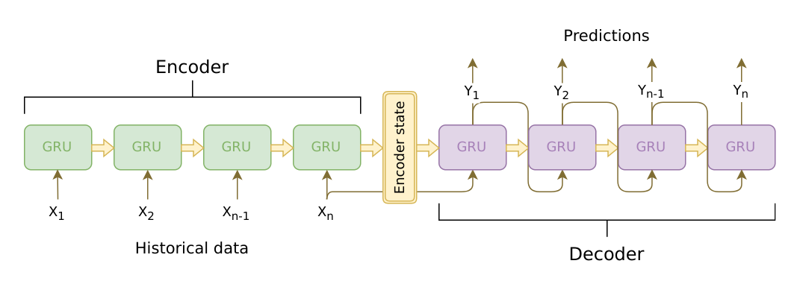
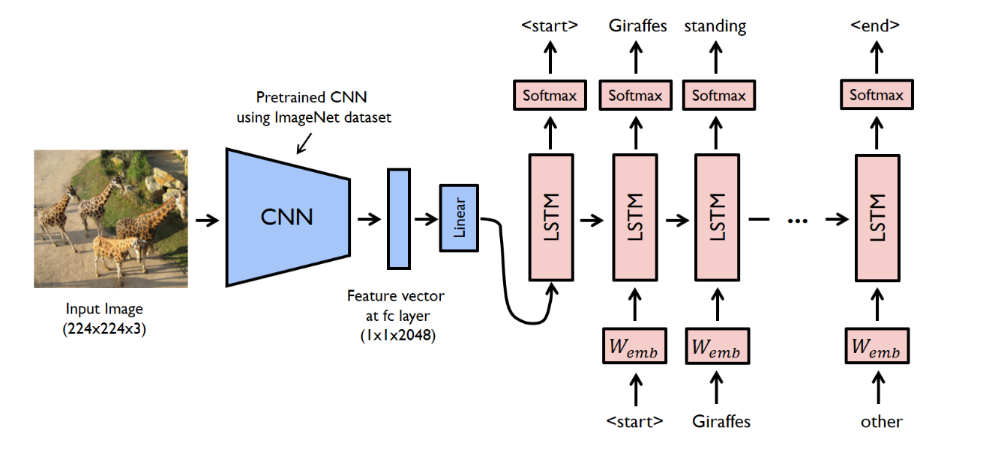
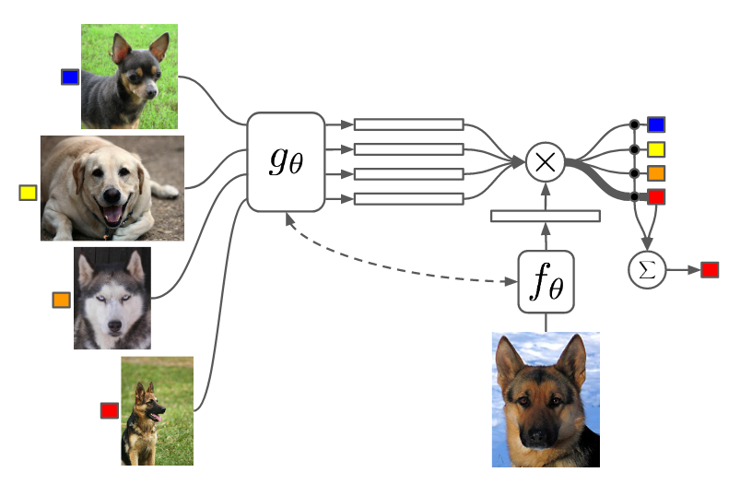
Encode Decode Paradigm
Seq2Seq
Image/video captioning
Matching Networks

Slide 10
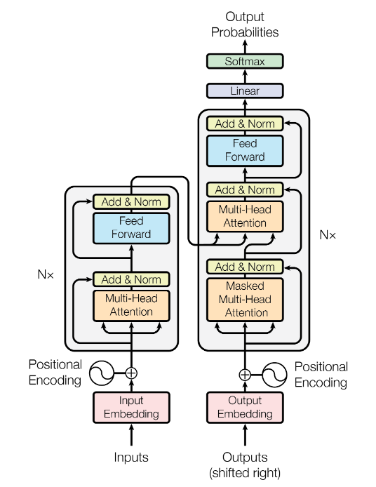
Transformer Network
Designed for machine Translation tasks
Sequence to sequence model
Encodes document into a vector
Decodes Vector to Document in new language
Replaces Bidrectional LSTMs with attention mechanism
Encoding portion can be trained and used without the decoder to form a general language model.

Slide 11
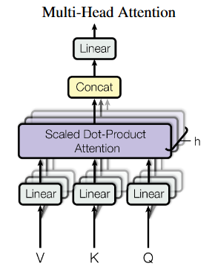
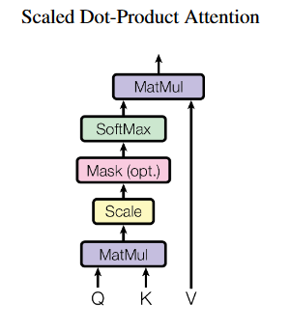
Attention Mechanism

Slide 12
BERT vs GPT-2
 | BERT | GPT-2
Neural Net Architecture | Transformer (12 layer encoder) Bidirectional | Transformer (12 layer encoder) Left to right
Data | BooksCorpus, Wikipedia | 40GB of text from Reddit links with 3+ karma
Pretraining tasks(s) | Masked Language Model (MLM), sentence concurrence | Predict Next word
Out of the box uses | Fill in the blank, sentence concurrence | Text generation
Size (# trainable params) | 110M, (base), 340M (large) | 117M (small), 345M (medium), 1500M (large, unreleased)

Slide 13
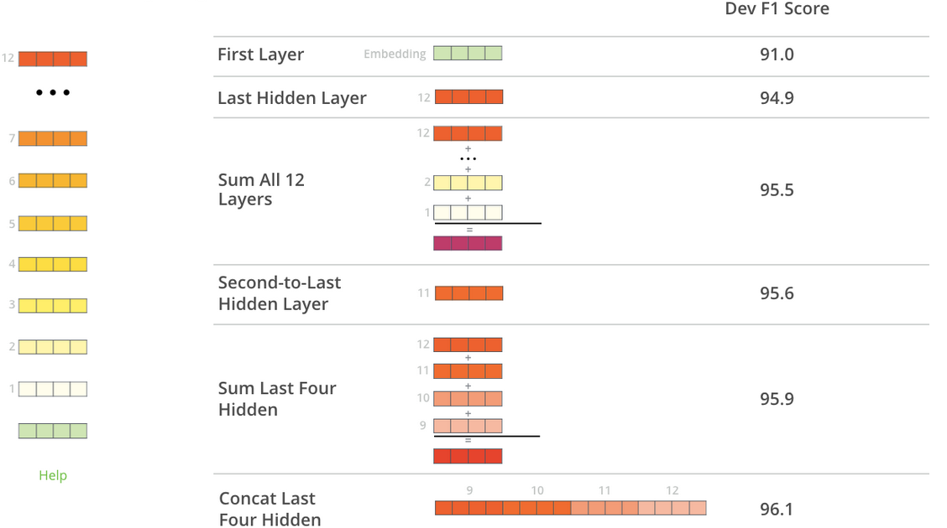
BERT for Feature extraction
Using Bert for feature extraction skips the need for fine tuning
Performance on contextualized embeddings close to fine tuning performance (96.4)

Slide 14
Code Demo
Spacy
Text processing
Various NLP tasks
BERT
Fill in the Blank
Next Sentence
GPT2
Writing prompt
Resources
Spacy: https://spacy.io/
BERT: https://github.com/google-research/bert
GPT-2: https://github.com/openai/gpt-2
BERT & GPT-2 for pyrotch: https://github.com/huggingface/pytorch-pretrained-BERT
BERT embeddings : https://github.com/allenai/allennlp

Slide 15

Questions?

